Slide 1


INT-362
KVM install

Slide 2
Set up nested virtualization in VMWare Workstation
Navigate to the VM Settings - Hardware page for the VM you would like to edit.
Click Edit in the Guest OS settings section.
Click the checkbox for Enable nested virtualization.

Slide 3
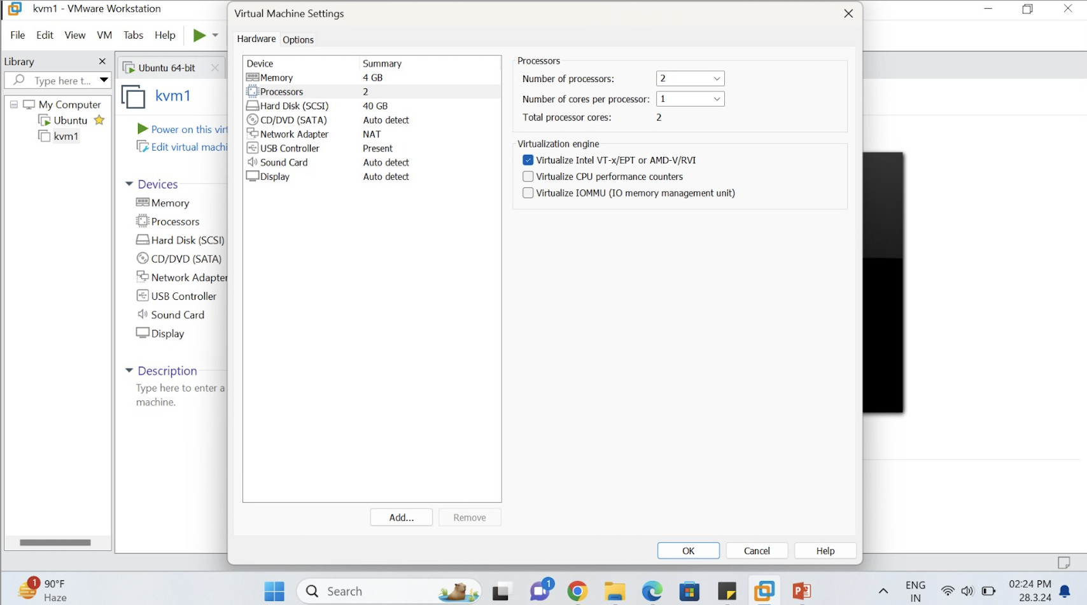
Set up nested virtualization in VMWare Workstation

Slide 4
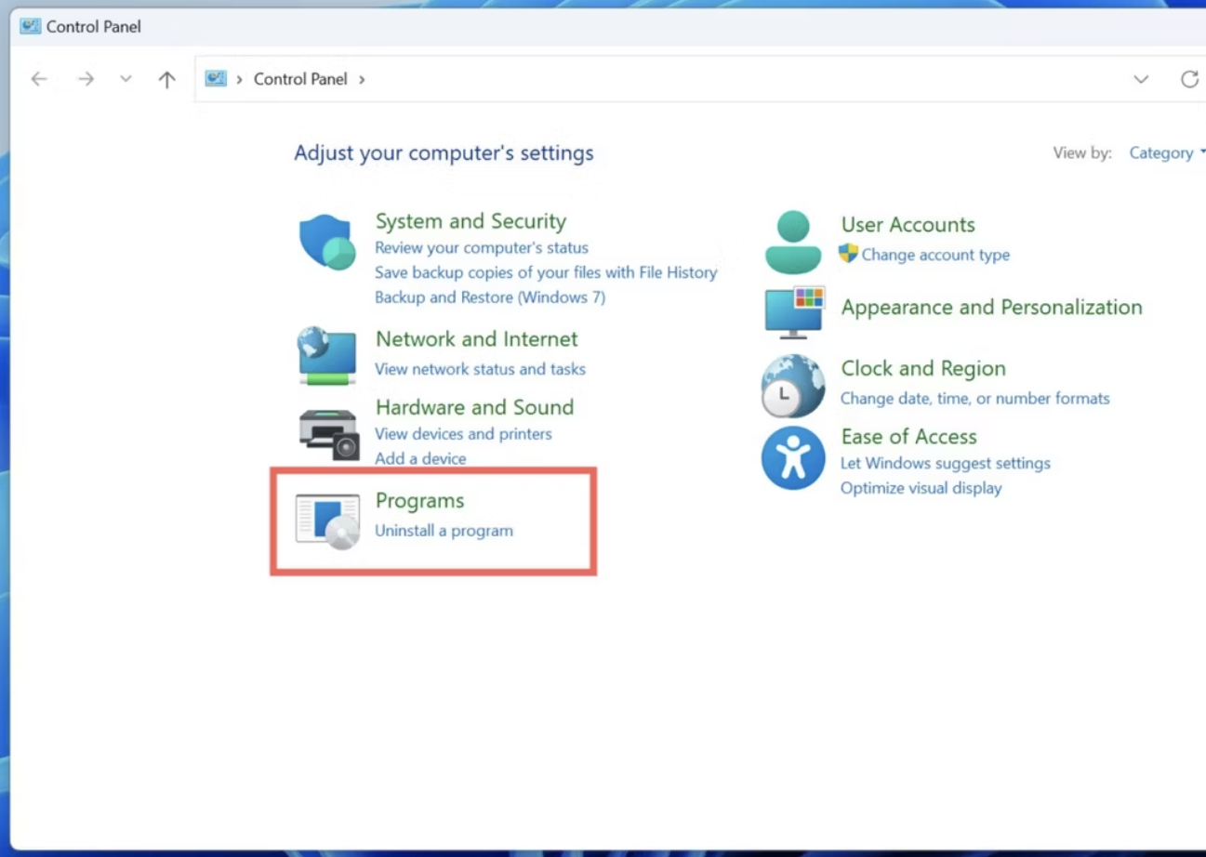
How to disable Hyper-V in Windows 11 using Control Panel
The simplest way to turn off Hyper-V on your PC involves navigating through Windows Features in the Control Panel.
Type "Control panel" into the Search Bar and click on the Control Panel suggestion.
Click on Programs

Slide 5
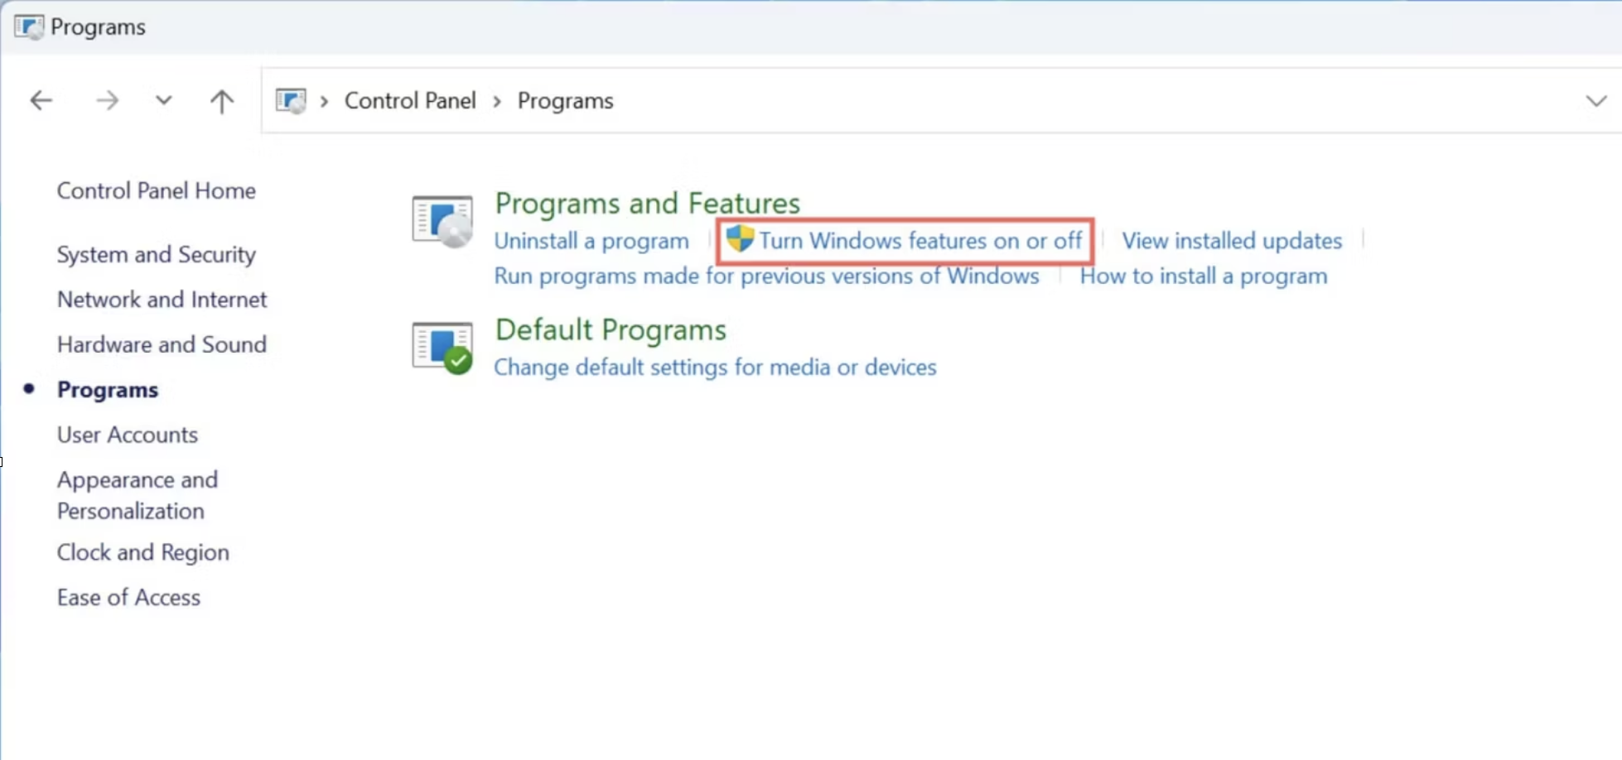
Select Turn Windows features on or off

Slide 6
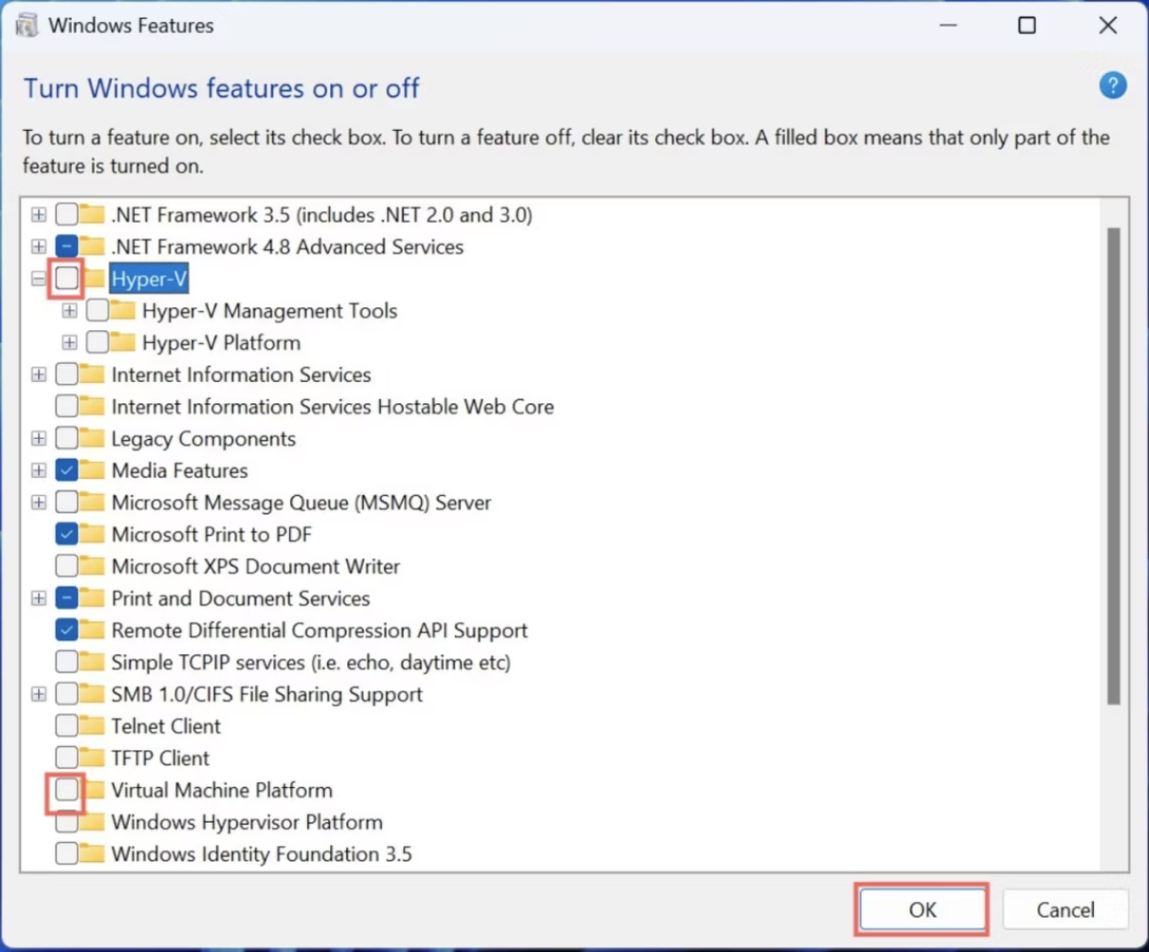
Scroll down until you spot Hyper-V in the Windows Features window and click on the checkmark next to it to disable Hyper-V.
INT-362
Adding hosts

Slide 7
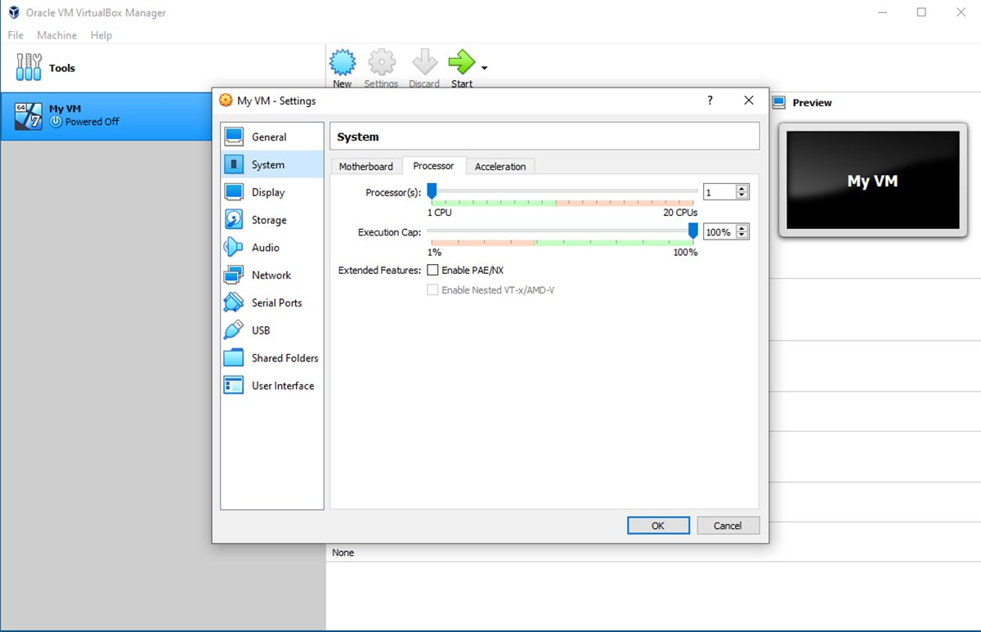
Set up VirtualBox nested virtualization
The system settings are divided into a series of tabs. Select the Processor tab, then the Enable Nested VT-x/AMD-V checkbox and click OK. Now the VM is ready for nested virtualization
open the settings of (powered off) virtual machine and go to System -> Processor, the option "Enable Nested VT-x/AMD-V" is greyed out and if it cannot be enabled.
open a new PowerShell in your VB installation folder and type:
./VBoxManage modifyvm "Virtual Machine Name" --nested-hw-virt on

Slide 8
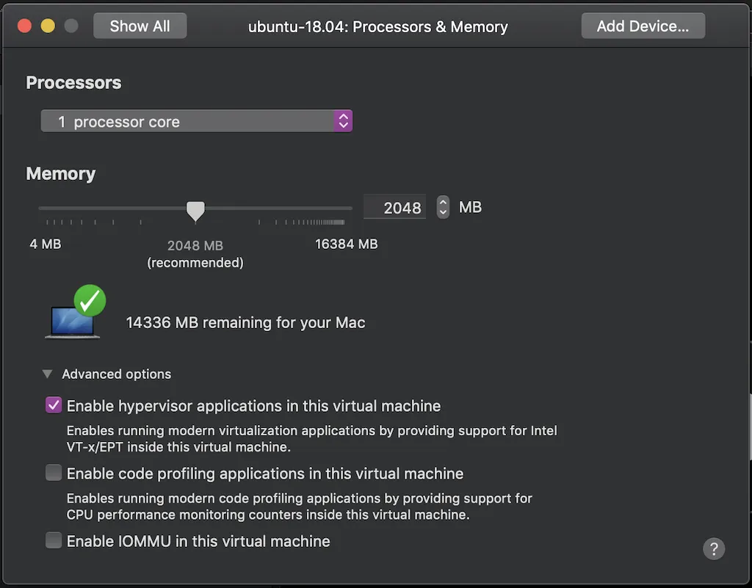
Set up nested virtualization in VMWare Fusion in MAC
It can be enabled by ticking the Enable hypervisor applications in this virtual machine option. This is found in the advanced options of the Processors & Memory screen for the virtual machine you want to run nested virtualization on.

Slide 9
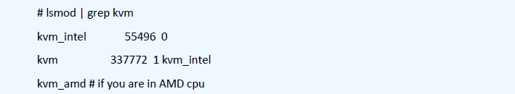
KVM install
Installation of KVM and Cloud Stack Agent in Ubuntu
For the sake of completeness, the user should check if KVM is running ok on the machine using the following command:
Sudo kvm-ok

Slide 10
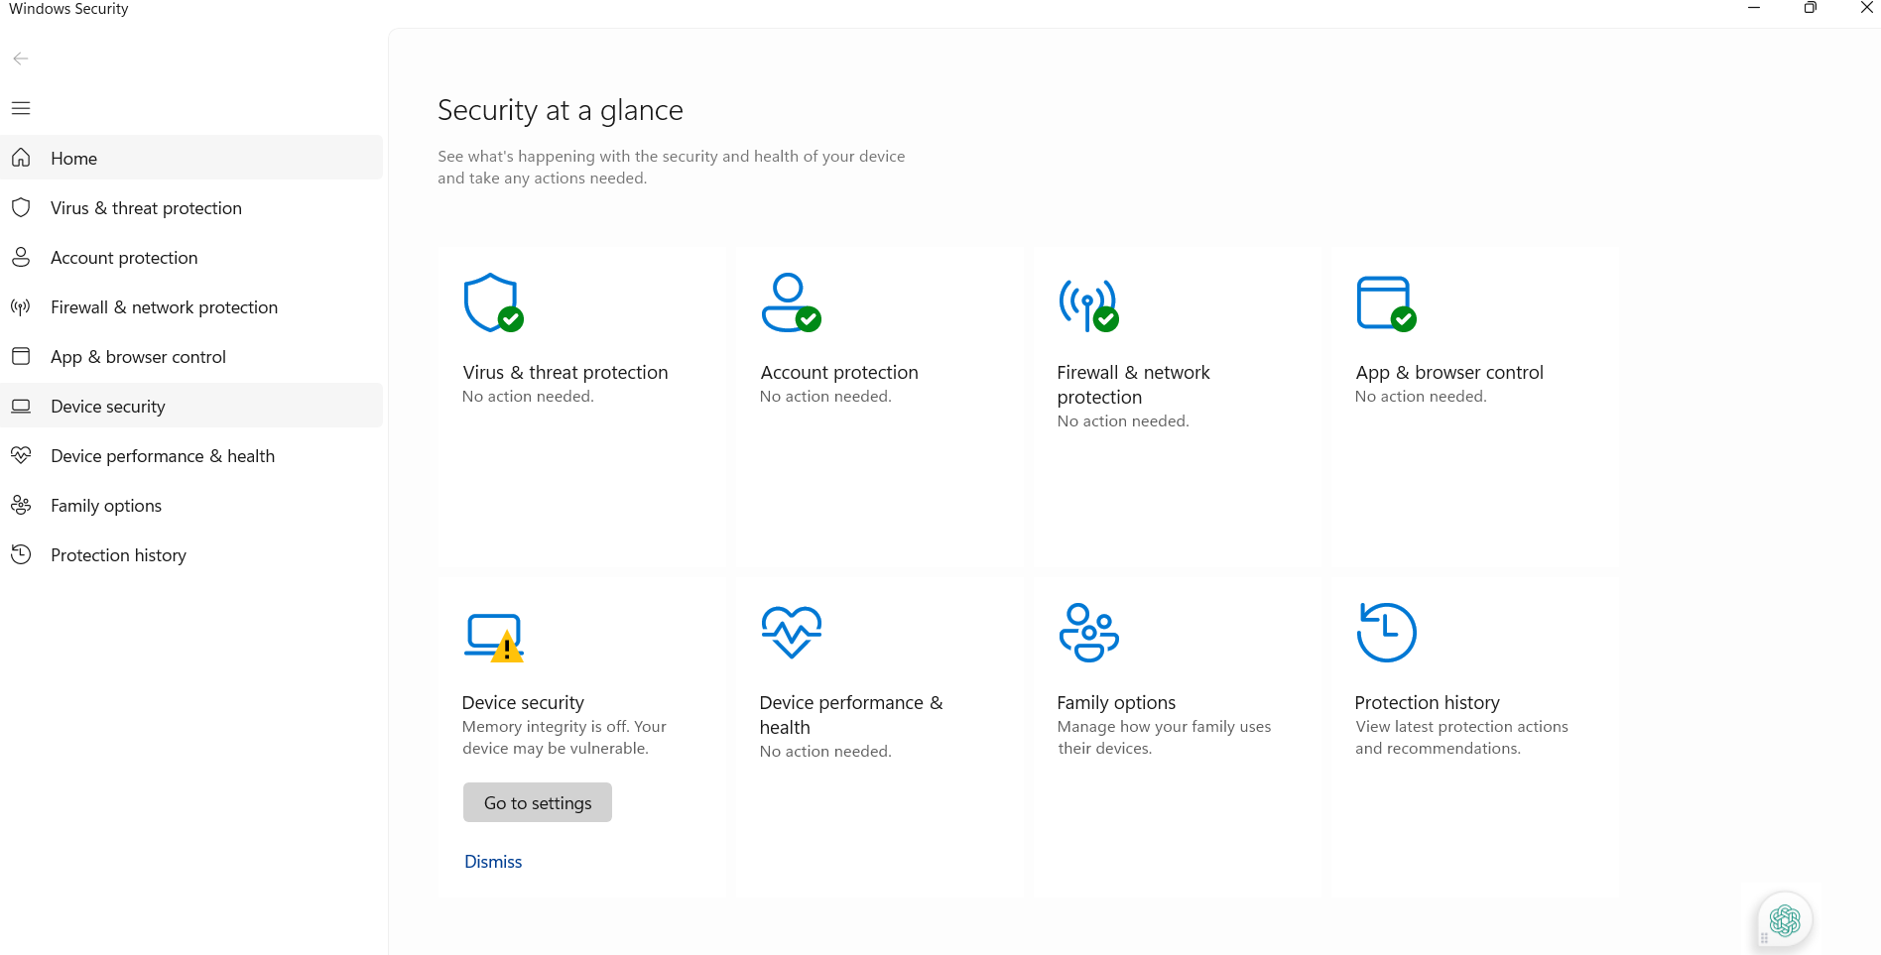
KVM install
Note:
Perform the following steps:
Go to: settings→ windows security→ Device Security→ core isolation→ memory integrity off
Step1: window security →device security →

Slide 11
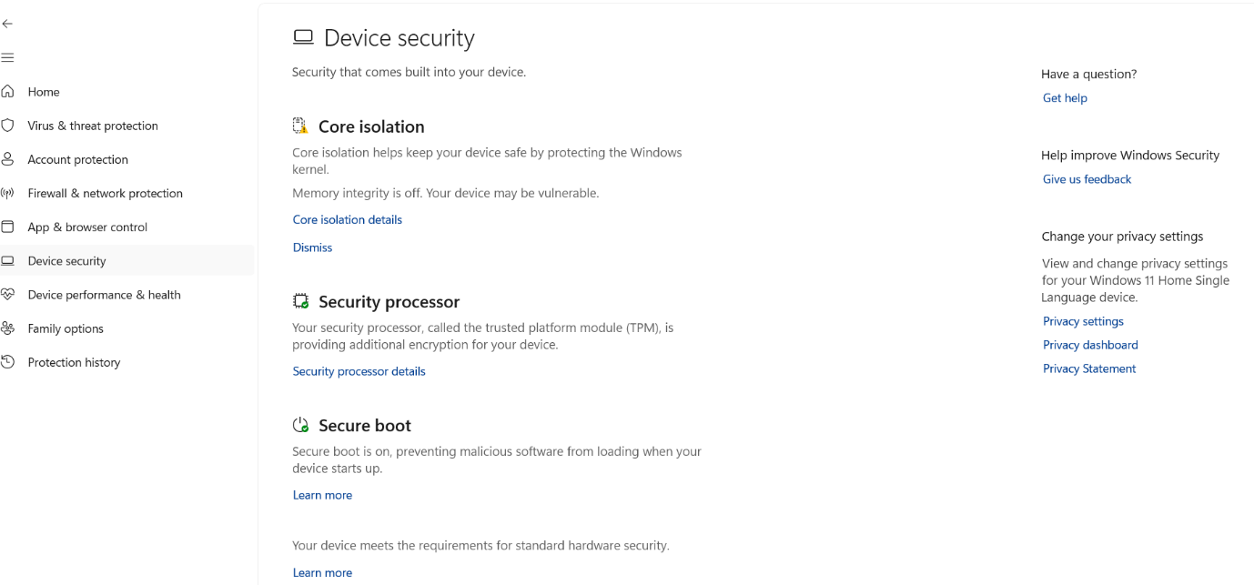
KVM install
Note:
Perform the following steps:
Go to: settings→ windows security→ Device Security→ core isolation→ memory integrity off

Slide 12
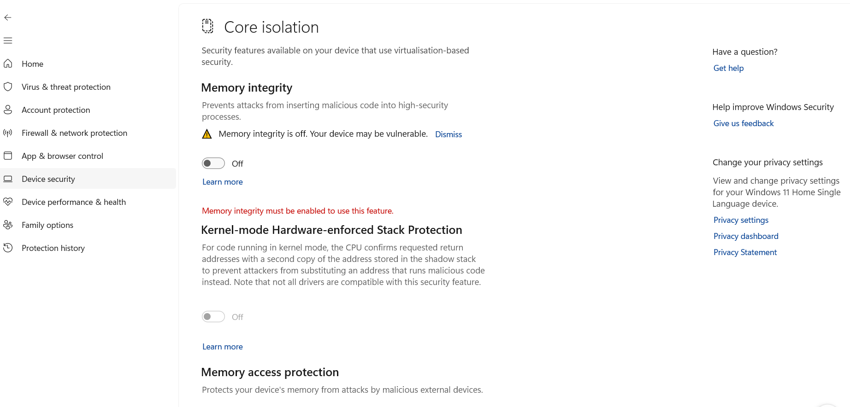
KVM install
Note:
Perform the following steps:
Go to: settings→ windows security→ Device Security→ core isolation→ memory integrity off
Step 3

Slide 13
INT-362
Preparation for KVM install
In your Virtualbox or VMWare workstation
Turn on nested virtualization —processor enable vtx
Ensure windows allows nested virtualization
Ensure core isolation is turned OFF
check using sudo kvm-ok
egrep -c '(vmx|svm)' /proc/cpuinfo

Slide 14
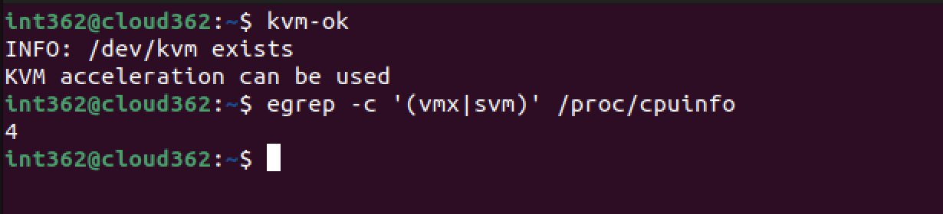

Slide 15
INT-362
Preparation for KVM install
After ensuring cloudstack is up and running you will need to install a few new packages
on your terminal run the following
apt install -y openssh-server
apt install -y cpu-checker
apt install -y cloudstack-agent

Slide 16
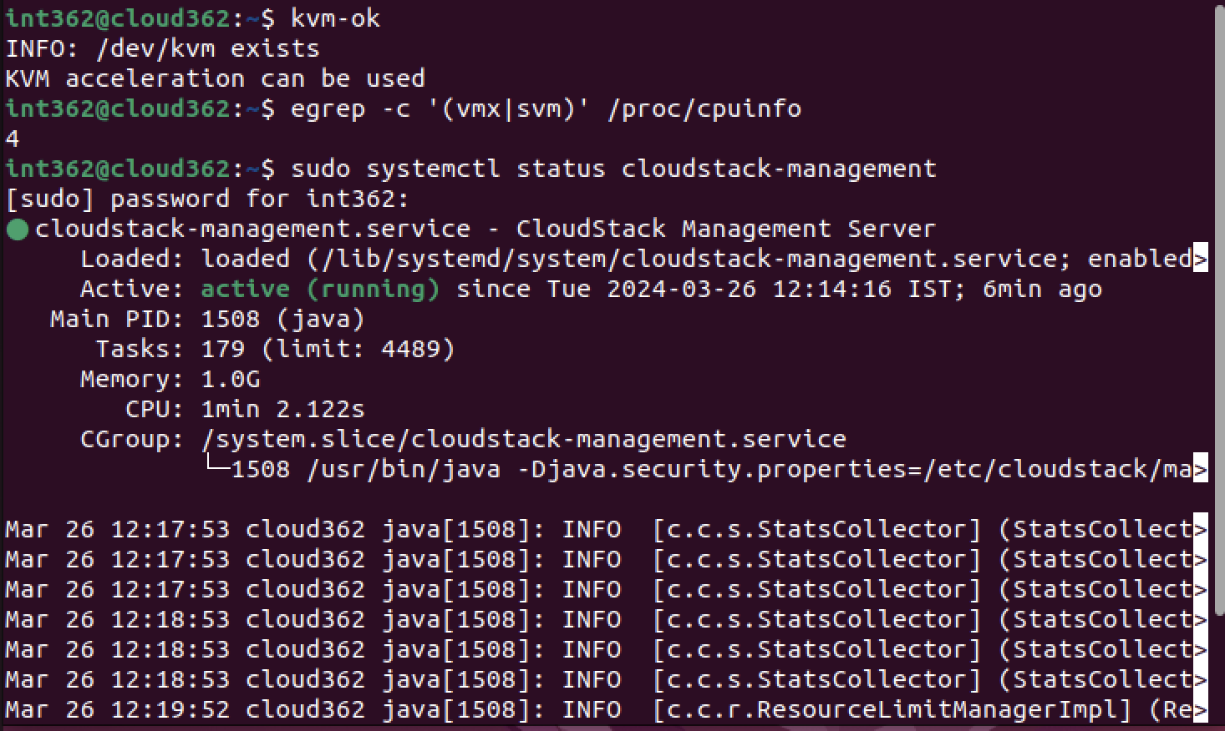

Slide 17
INT-362
Preparation for KVM install
Setup domain name because you have to install kvm and management server to same machine
hostname --fqdn
this command tells you your complete name, for ex it is server.cloud.c1, then do
sudo nano /etc/idmapd.conf
here uncomment domain and write the domain name from your hostname
now my domain name will be cloud.c1

Slide 18
INT-362
Edit permission
You should run these in root mode by entering
su root and your password
sed -i -e 's/\#vnc_listen.*$/vnc_listen = "0.0.0.0"/g' /etc/libvirt/qemu.conf
systemctl mask libvirtd.socket libvirtd-ro.socket libvirtd-admin.socket libvirtd-tls.socket libvirtd-tcp.socket
systemctl restart libvirtd
apt-get install uuid
UUID=$(uuid)
echo host_uuid = \"$UUID\" >> /etc/libvirt/libvirtd.conf

Slide 19
INT-362
Edit permission
You should run these in root mode by entering
su root and your password
Sudo nano /etc/libvirt/libvirtd.conf
echo host_uuid = \"$UUID\" >> /etc/libvirt/libvirtd.conf

Slide 20
INT-362
Edit permission
You should make these settings in /etc/libvirt/libvirtd.conf, uncomment the lines
listen_tls=0
listen_tcp=0
tcp_port = "16509"
tls_port = "16514"
listen_addr = "192.168.0.1“ # set as your gateway
mdns_adv = 0 # this line needs to be added separately
auth_tcp = "none"
Save and exit
systemctl restart libvirtd

Slide 21
INT-362
Edit permission
You should make these settings in /etc/cloudstack/agent/agent.properties, change these lines
host=[give your management server ip here]@static
This should look like host=10.0.2.15@static
Uncomment the lines
private.network.device=cloudbr0
public.network.device=cloudbr0
guest.network.device=cloudbr0
Make sure all use cloudbr0
After making these changes, restart libvirt, restart cloudstack-agent

Slide 22
INT-362
Edit permission
You should run these in root mode by entering
su root and your password
ln -s /etc/apparmor.d/usr.sbin.libvirtd /etc/apparmor.d/disable/
ln -s /etc/apparmor.d/usr.lib.libvirt.virt-aa-helper /etc/apparmor.d/disable/
apparmor_parser -R /etc/apparmor.d/usr.sbin.libvirtd
apparmor_parser -R /etc/apparmor.d/usr.lib.libvirt.virt-aa-helper

Slide 23
INT-362
Configure Networks
Bridging will be needed between management server and KVM
Go to sudo nano /etc/netplan/01-network-manager-all.yaml
Visit tinyurl.com/int362cp to find contents of this file
you should know by now what needs to be replaced in this, close and exit
sudo netplan apply or netplan --debbug apply
sudo systemctl restart NetworkManager

Slide 24
INT-362
Configure Firewall
Your firewall needs information on working ports so run these
$ ufw allow proto tcp from any to any port 22
did you get permission denied.... who will give sudo in front?
$ ufw allow proto tcp from any to any port 1798
$ ufw allow proto tcp from any to any port 16514
$ ufw allow proto tcp from any to any port 5900:6100
$ ufw allow proto tcp from any to any port 49152:49216
or you could get rid of it using
sudo ufw disable

Slide 25
INT-362
Configure additional settings
Now check status of a few services if they are functional
In an extreme case you might need to pick up host_uuid without quotes from
nano /etc/libvirt/libvirtd.conf
find the host-uuid in end of file, copy the uuid
then open sudo nano /etc/cloudstack/agent/agent.properties
paste in from of guid=

Slide 26
INT-362
Try adding host
Unable to add host?
Troubleshoot!!! Check logs
sudo systemctl status libvirtd
sudo systemctl status cloudstack-agent
sudo journalctl -xeu cloudstack-agent

Slide 27
INT-362
Everything seems fine ?
Go to management server in browser and add host
setup the ip addresses properly

